Slide 1
Chicago (NB) Style—Part II
Footnotes/Endnotes

Slide 2
Notes—The Basics
Insert a note (footnote or endnote) whenever you cite a fact or give a quotation or paraphrase.
A superscript number in the text refers to a note with a matching number.
Let MS Word handle the numbers and the notes. Don’t try to insert superscripts and notes yourself.
The first note for a source is a full citation. (See the format for each type of source.)
For subsequent notes, give only the author, the title, and the page number.
Consecutive notes use “Ibid” and page number.
Use the note form, not the bibliography form.

Slide 3
Example 1

Slide 4
Example 2

Slide 5
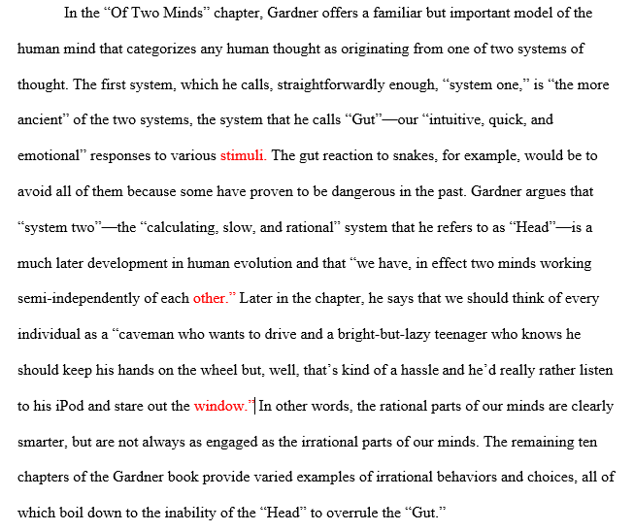
Use MS Word!

Slide 6
Go to References. Choose Insert Footnote/Endnote

Slide 7
Go to References. Choose Insert Footnote/Endnote

Slide 8
Questions?
Writing Center
Kearns 203
(843) 349-2937

